Slide 1
Module 4: Exploratory Data Analysis
Course Teacher: Mr. Kiran P. Kamble

Slide 2
What to Study?
Discrete and continuous random variables
PDF
CDF
Percentile
Inter quartile range
Central tendency (mean, mod, median, dispersion, skewness, kurtosis)
Variance
Standard deviation,
Mean Absolute Deviation (MAD)
Standardization (Z-score)
Normalization

Slide 3
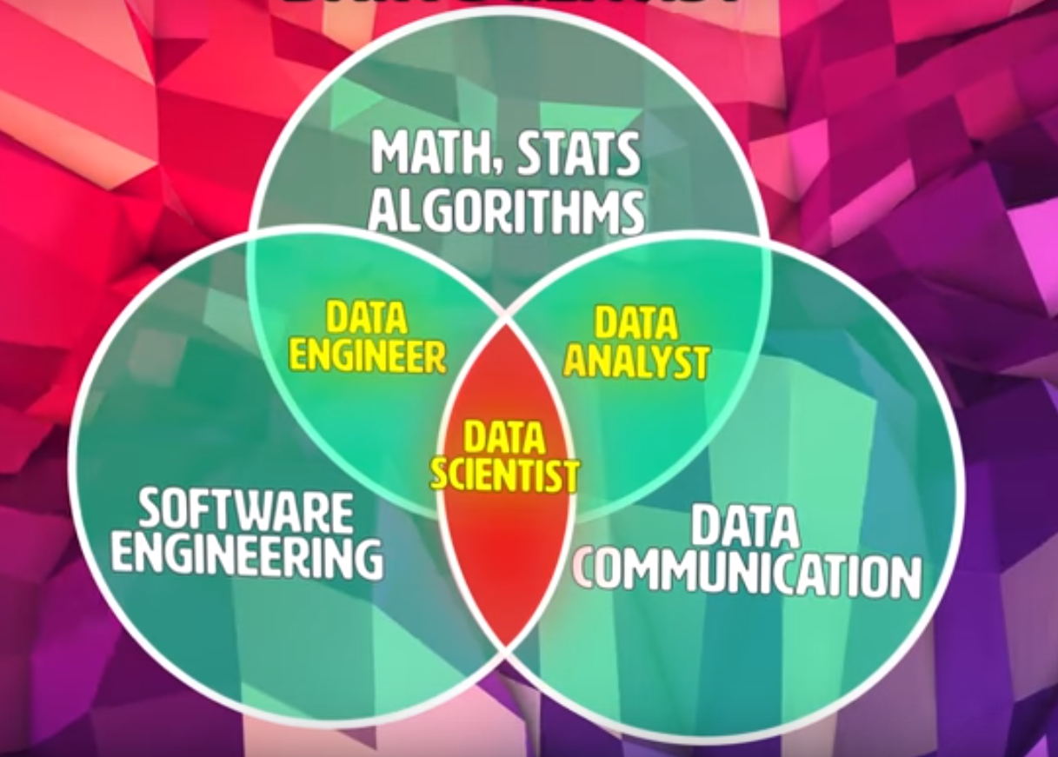
Introduction

Slide 4
Random variables?
Basic idea and definitions of random variables

Slide 5
Discrete and continuous random variables
Defining discrete and continuous random variables. Working through examples of both discrete and continuous random variables

Slide 6
Constructing a probability distribution for random variable
How to create the probability distribution of the number of "heads" after 3 flips of a fair coin

Slide 7
Practice: Constructing probability distributions
Ajay is going to invest his money into 2 different stocks. Both stocks are independent, and each stock has a 50% chance of being successful and a 50% chance of failing.
Each stock will make Ajay $500 if it succeeds or lose him $500 if it fails.
If X is a random variable that represents Ajay's profit from investing in these 2 stocks, drag the bars to graph the probability distribution for all possible values of X.

Slide 8
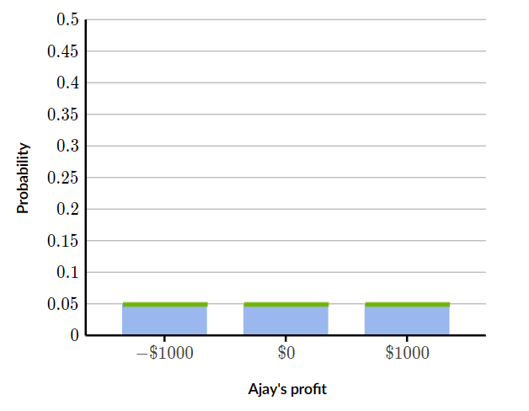
Practice: Constructing probability distributions

